Slide 1
Measuring Internet Access “Speed”: Five Lessons
Nick Feamster Computer Networking

Slide 2
Summary: Five Lessons
“Speed” has many facets.
Different techniques measure different aspects of speed.
Many factors can limit a client-based speed test.
Faster “speed” doesn’t mean better performance.
As speeds get faster, speed testing gets harder.

Slide 3
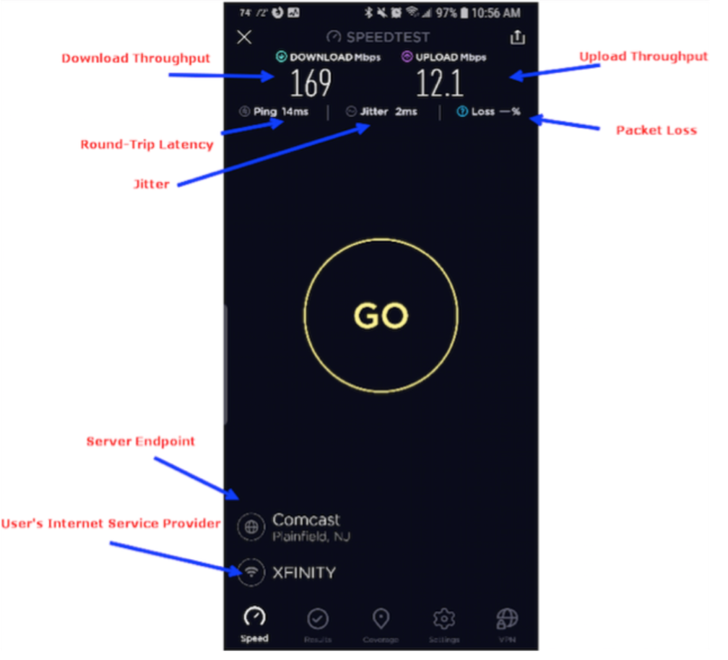
“Speed” Has Many Facets
Throughput (up, down)
Latency
Jitter
Packet Loss

Slide 4
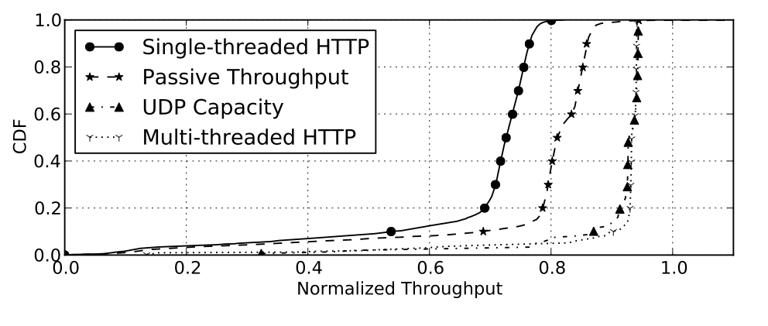
Different Techniques Measure Different Aspects of Speed
NDT Design: “Transport Capacity” (TCP New Reno)
Ookla, SamKnows Design: “Link Capacity”
Sundaresan, S., Burnett, S., Feamster, N., & De Donato, W. (2014, June). BISmark: A Testbed for Deploying Measurements and Applications in Broadband Access Networks. In USENIX Annual Technical Conference (pp. 383-394).
Sundaresan, S., De Donato, W., Feamster, N., Teixeira, R., Crawford, S., & Pescapè, A. (2011, August). Broadband internet performance: a view from the gateway. In ACM SIGCOMM (Vol. 41, No. 4, pp. 134-145). ACM.

Slide 5
Many Factors Limit a Client-Based Speed Test
Client device (hardware, software)
Home network
Network path
Measurement server infrastructure
Test parameters (length, # connections)

Slide 6
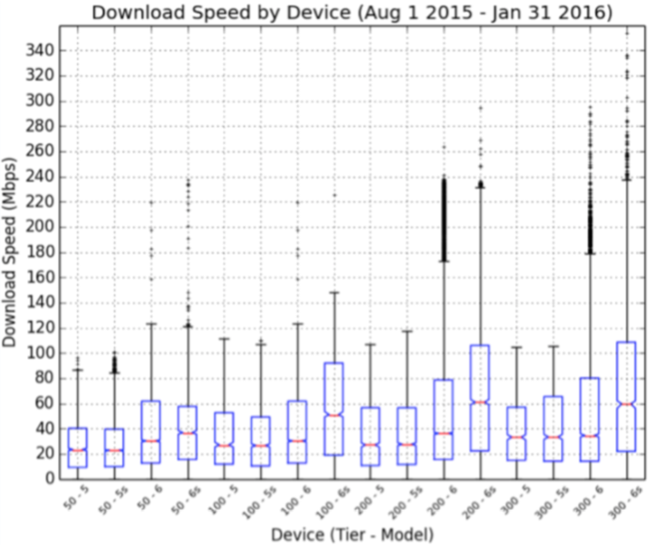
The Device Can be the Bottleneck
Older iPhones do not support 802.11ac, so never exceed 100 Mbps!

Slide 7
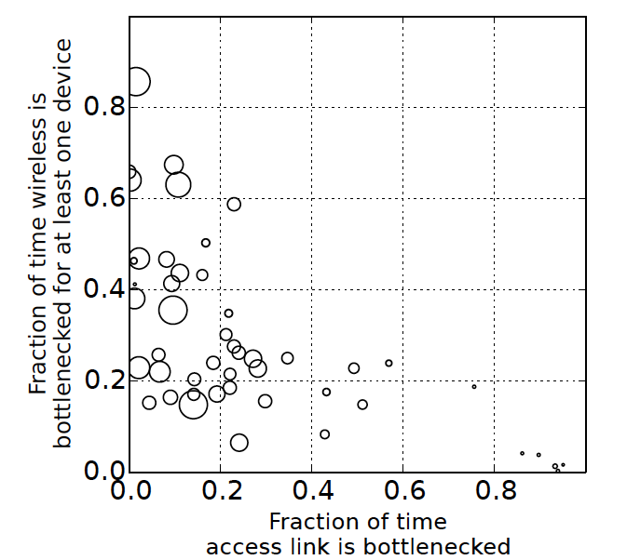
The Home Network Can Be the Bottleneck
Wireless bottlenecks are common, especially as throughput increases
Access link bottlenecks are rare, only happens at low throughput
Homes with throughput greater than 35 Mbits/s almost never see access link bottleneck. (2015)
Sundaresan, S., Feamster, N., & Teixeira, R. (2016, March). Home network or access link? locating last-mile downstream throughput bottlenecks. In International Conference on Passive and Active Network Measurement (pp. 111-123).

Slide 8
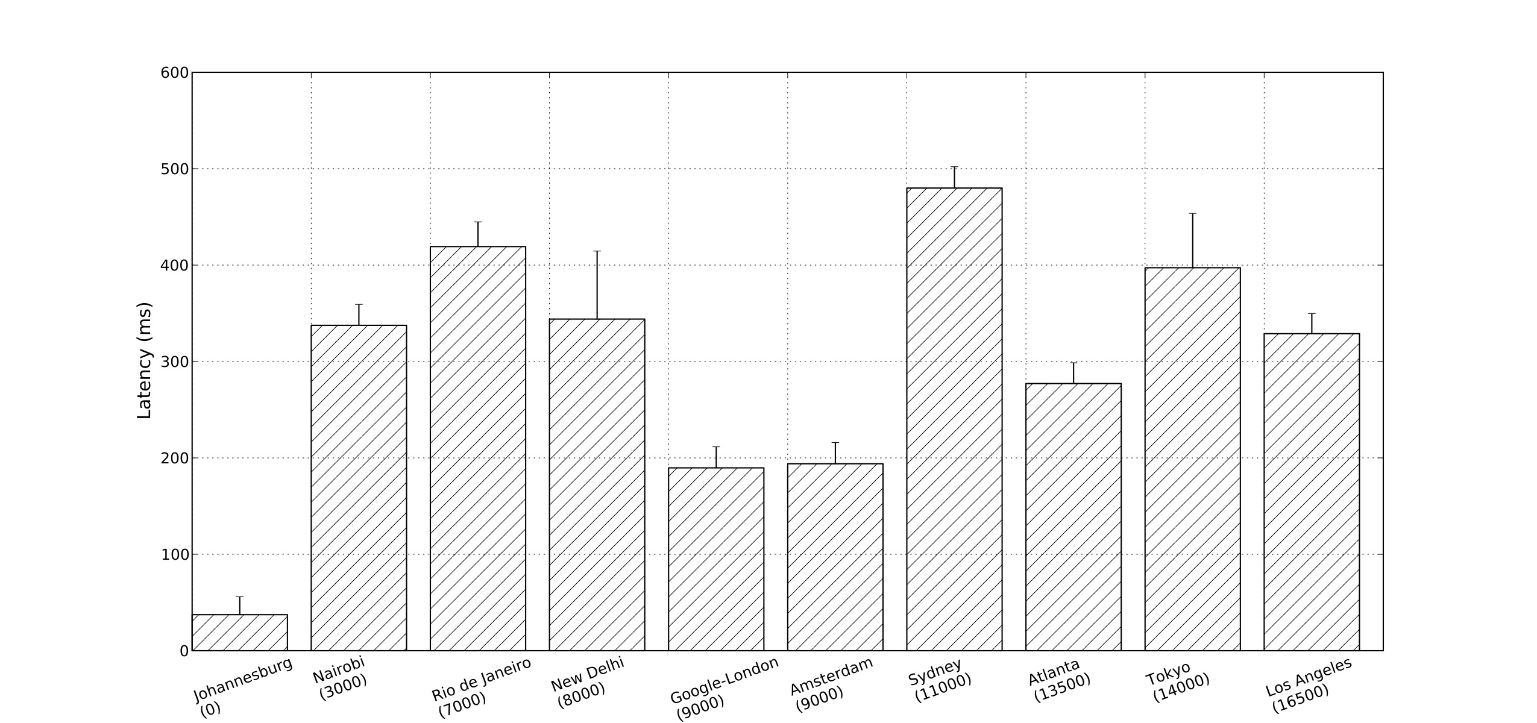
The Network Path can be the Bottleneck
Latencies from South Africa to Kenya, Brazil, India are 2x higher than latencies to Europe.
Connectivity to Australia, Japan also shows higher latency.
Gupta, A., Calder, M., Feamster, N., Chetty, M., Calandro, E., & Katz-Bassett, E. (2014, March). Peering at the Internet’s frontier: A first look at isp interconnectivity in Africa. In International Conference on Passive and Active Network Measurement (pp. 204-213).

Slide 9
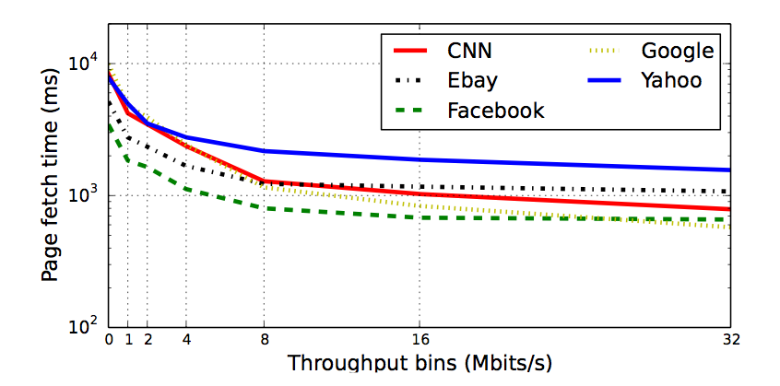
Faster Speed Doesn’t Mean Better Performance
Page load time stops improving above 16 Mbits per second.
Sundaresan, S., Feamster, N., Teixeira, R., & Magharei, N. (2013, October). Measuring and mitigating Web performance bottlenecks in broadband access networks. In ACM SIGCOMM Internet measurement conference (pp. 213-226). ACM. Community contribution award.

Slide 10
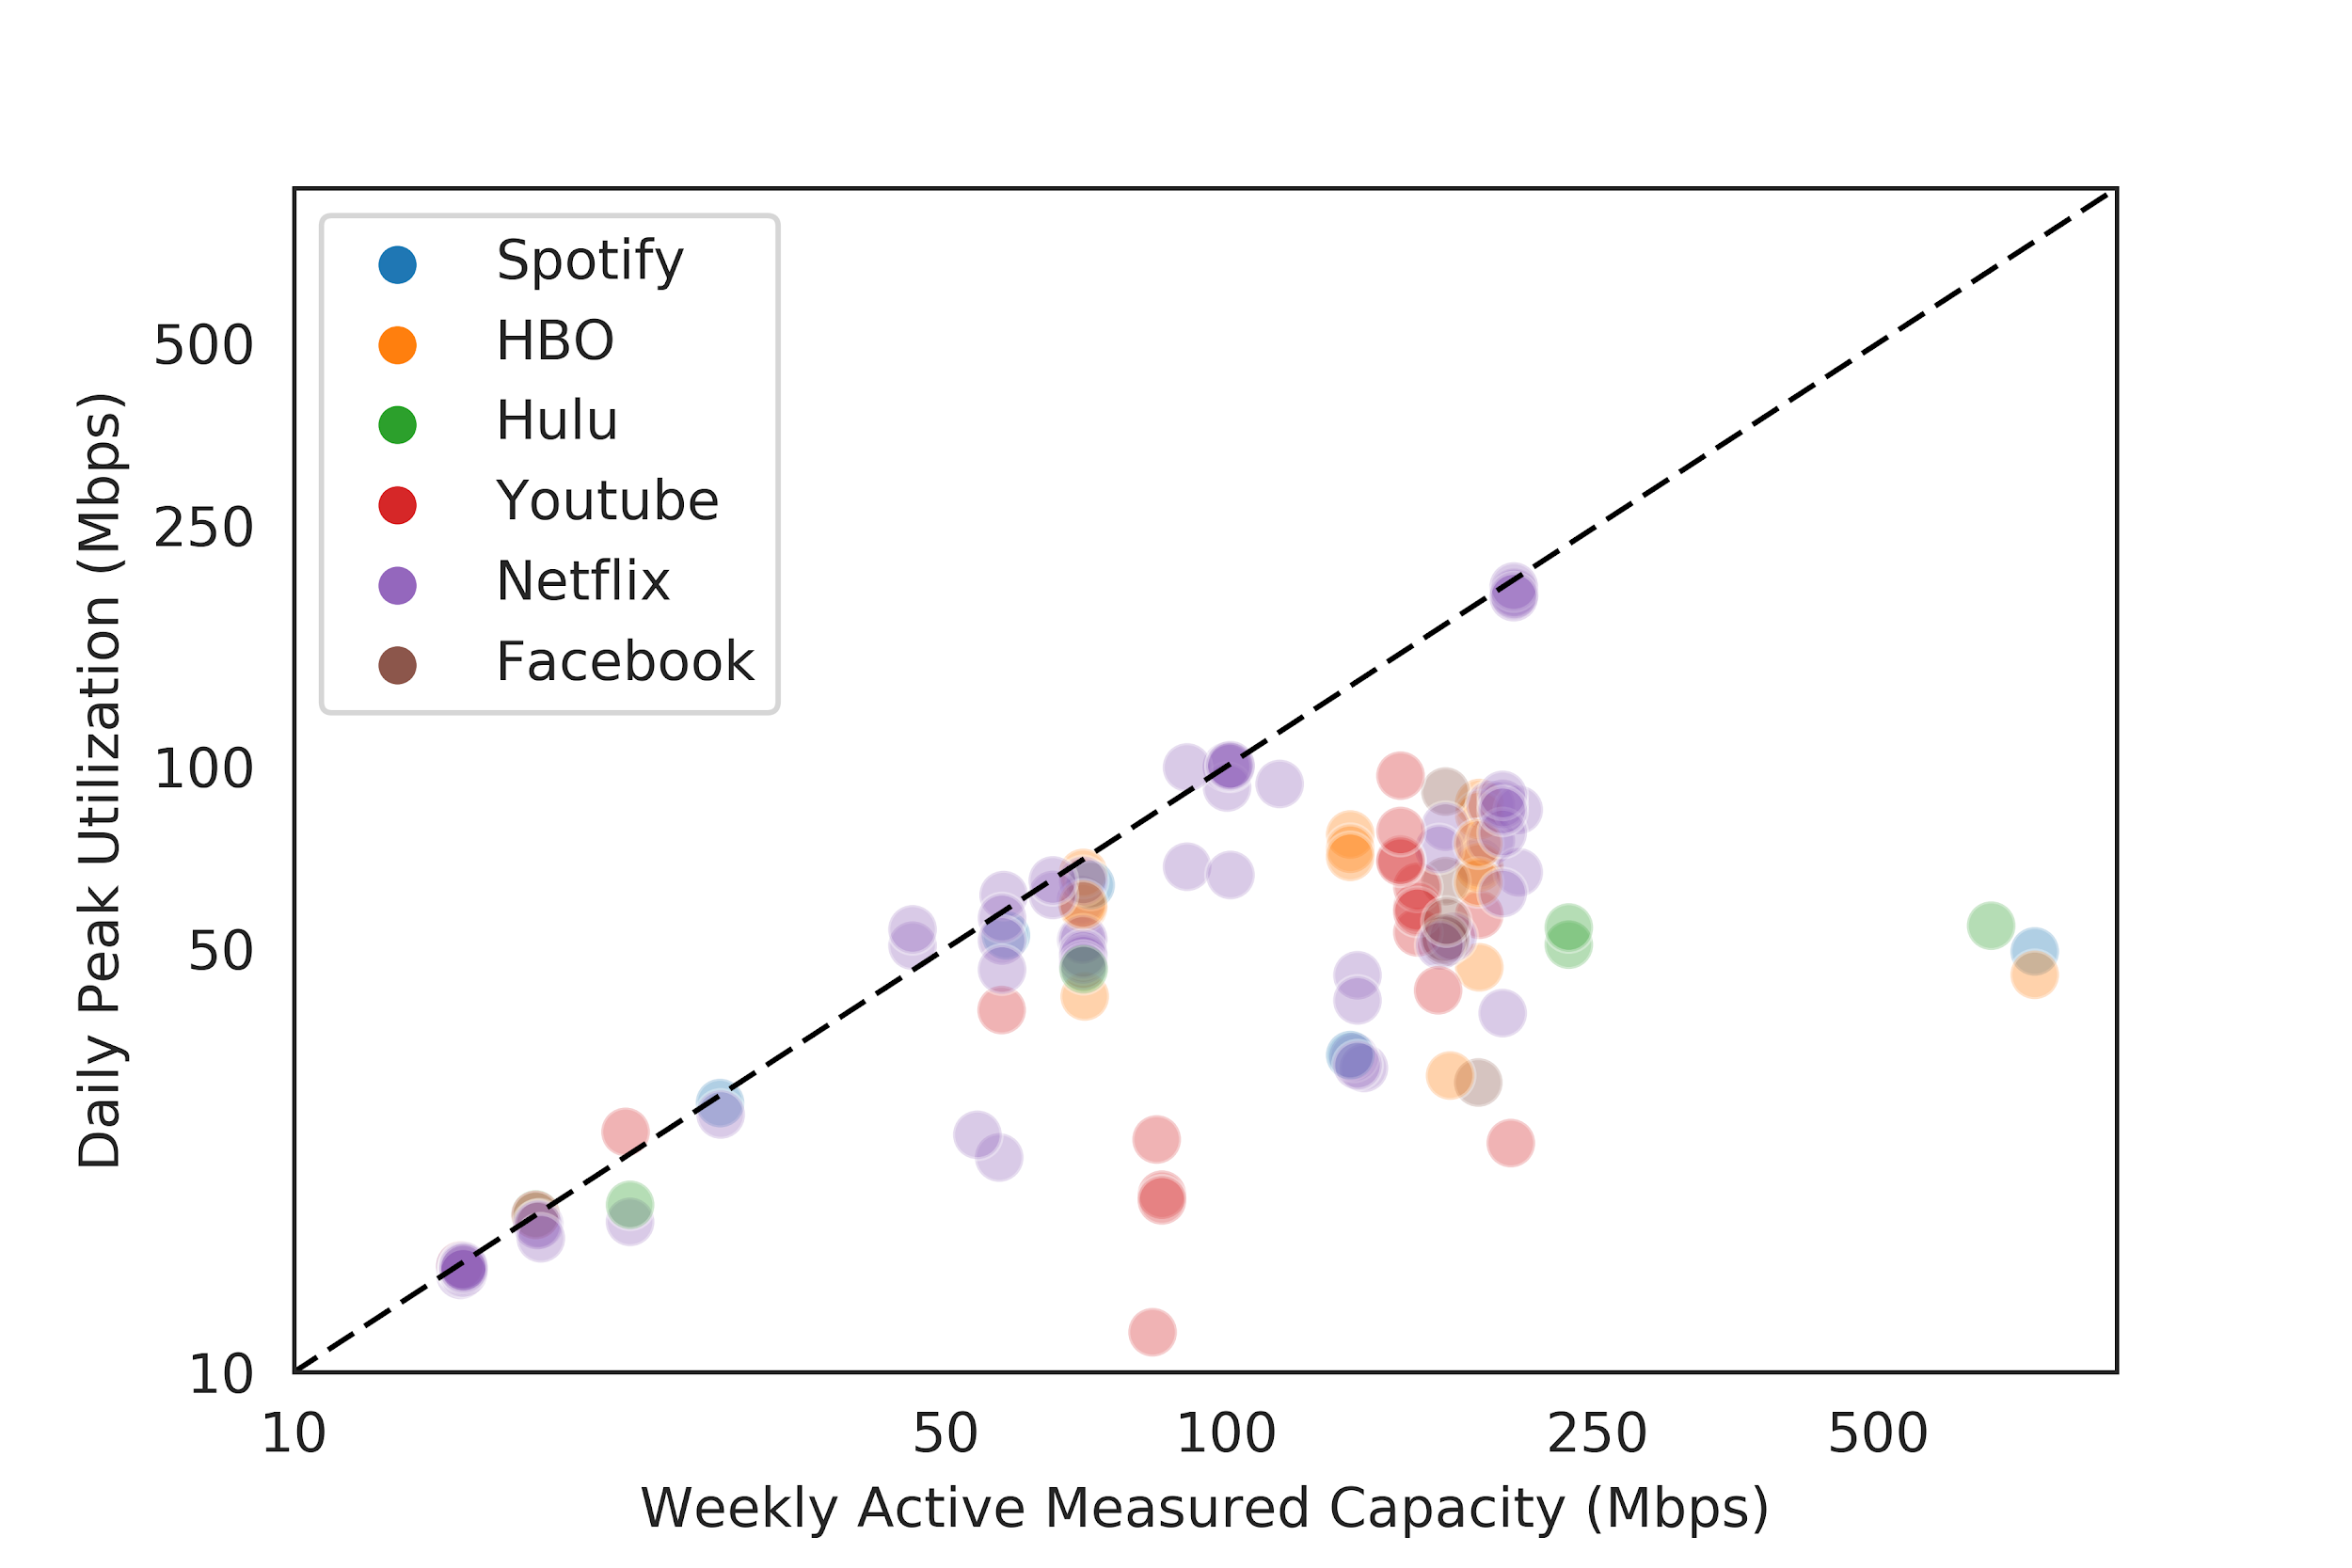
Application Performance Doesn’t Always Need “Top Speed”
Applications often do not consume link capacity.

Slide 11
User Experience Depends on Application Performance
Startup delay: How long does the video take to start playing?
Video resolution: What is the resolution of the video?
Bitrate changes: Does the video bitrate change during playback?
Rebuffering events: Does the video re-buffer during playback?
Notes:
We aim to infer four high-level application quality metrics that past work has indicated are good proxies for user experience.
(In actual fact, you’d also want to ask the users, and we’ve actually done that in part of our work using experience sampling, but we haven’t even looked at the data there yet, so I won’t talk about it today.)

Slide 12
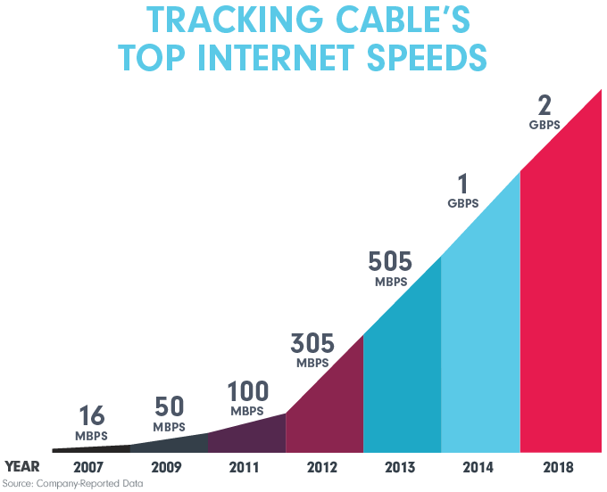
As Speeds Get Faster, Speed Testing Gets Harder
Measuring access links is getting harder.
Conventional tests take more data.
Bottlenecks are moving elsewhere.
Apps don’t saturate the access network capacity.
Notes:
This problem was never easy, but it’s getting more challenging!

Slide 13
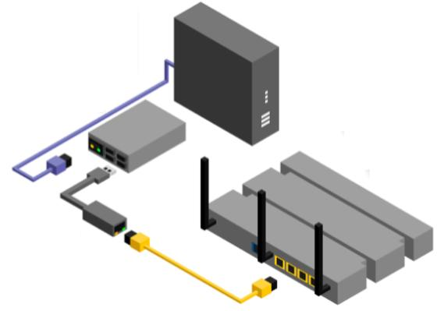
The Gigabit Era: The Future is Passive
Estimate application performance using mostly passive measurements without breaking encryption
Device is in-line, between cable modem and user’s wireless router, or off-path
Implemented in Go for low-cost devices (Raspberry Pi, Odroid) on home networks
Pilot home network deployment: ~60 in US, ~10 in Paris

Slide 14
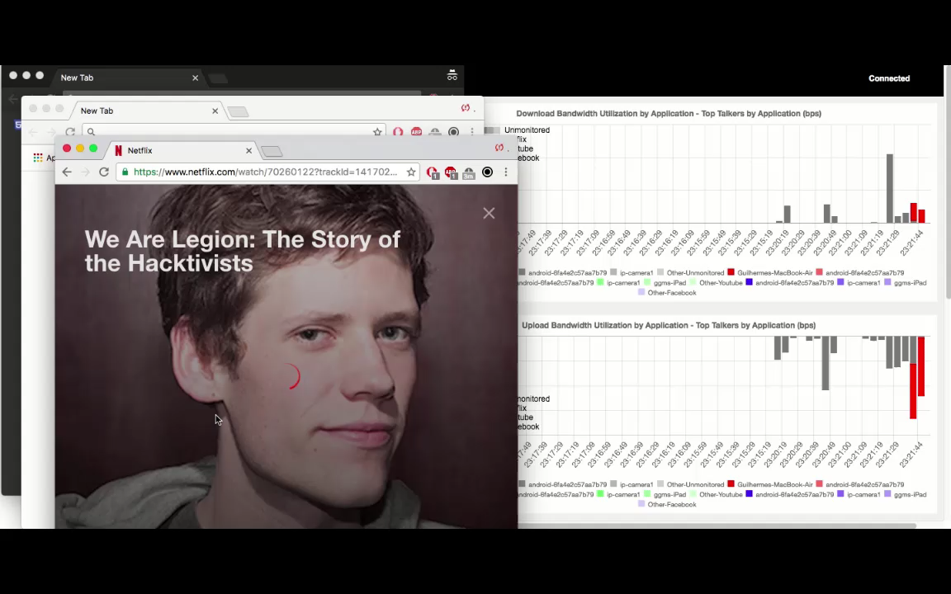

Slide 15
Summary
“Speed” has many facets.
Different techniques measure different aspects of speed.
Many factors can limit a client-based speed test.
Faster “speed” doesn’t mean better performance.
As speeds get faster, speed testing gets harder.
The future of testing is passive application monitoring.
feamster@cs.princeton.edu https://www.cs.princeton.edu/~feamster/

